Slide 1

Beyond Pixels: The Art of Satellite Data Visualisation
By Astro Hackers
James Carron, Daniel Alvarez Carreno, Thomas Fischer, Iva Sekulic

Slide 2

Why SARt Challenge?
Bridging the gap between the digital and the physical world
Illuminating significance of SAR sensors and their artistic potential

Slide 3
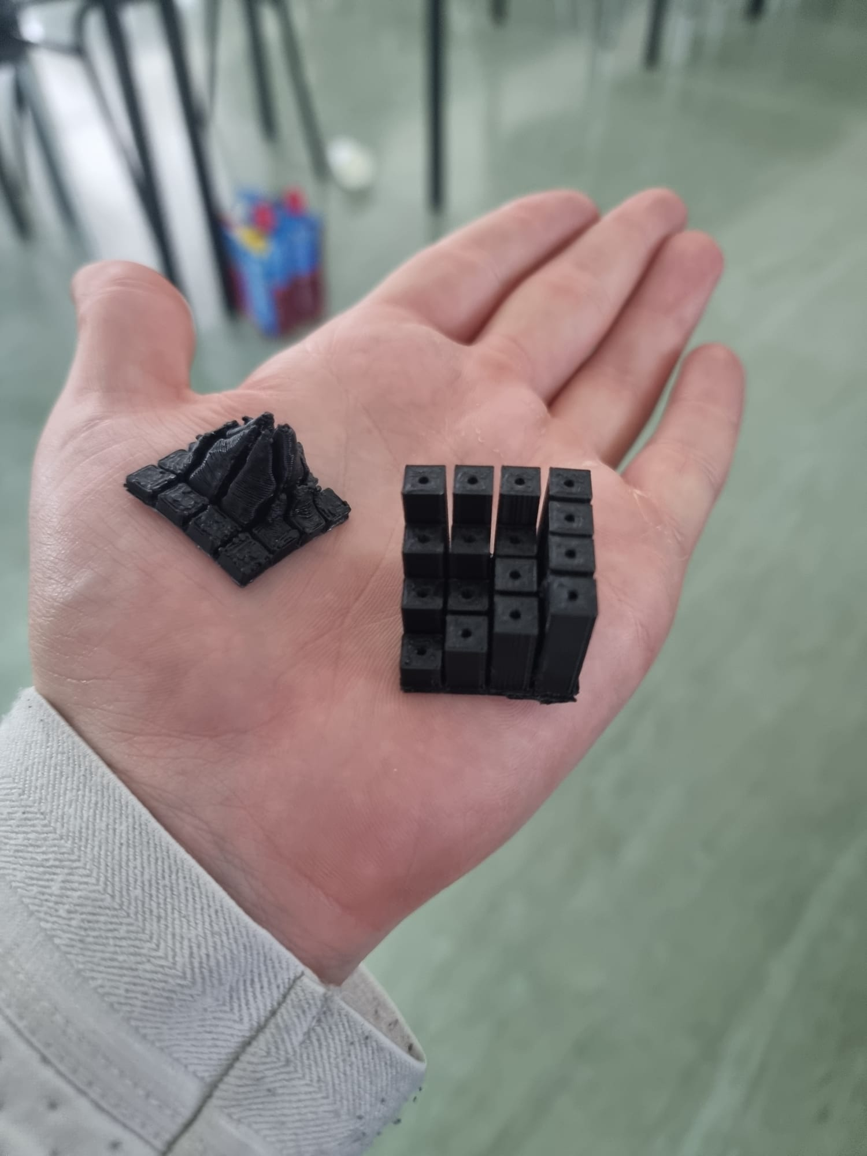
Bringing life to SAR data
Our model is tactile and tangible
Making geographical data representation come to life

Slide 4

Data Used
The Hofsjokull Glacier (Iceland) data was accessed through the NASA website
The binary files used were HGT files and the metadata files were used to help decode the files into python arrays

Slide 5

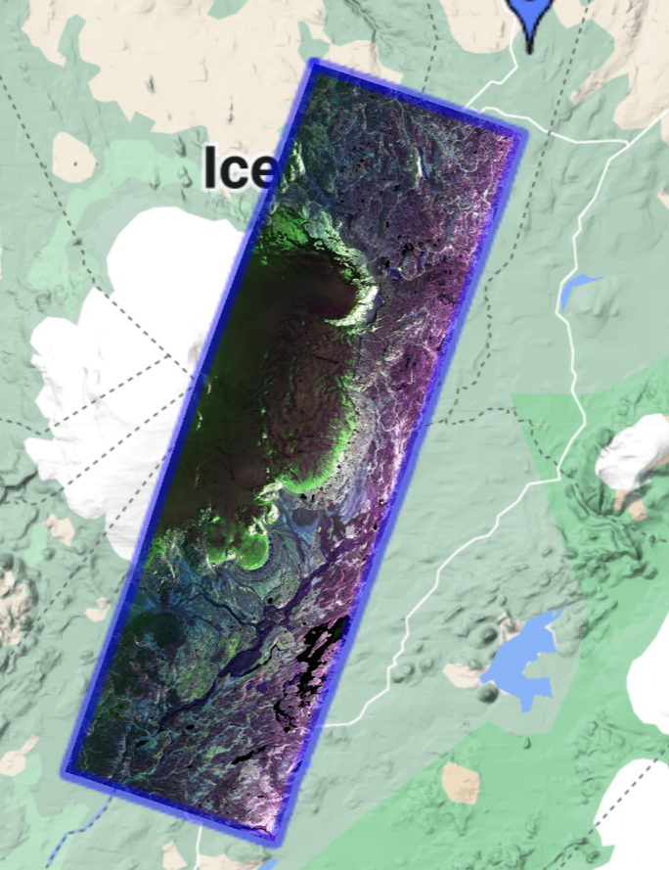
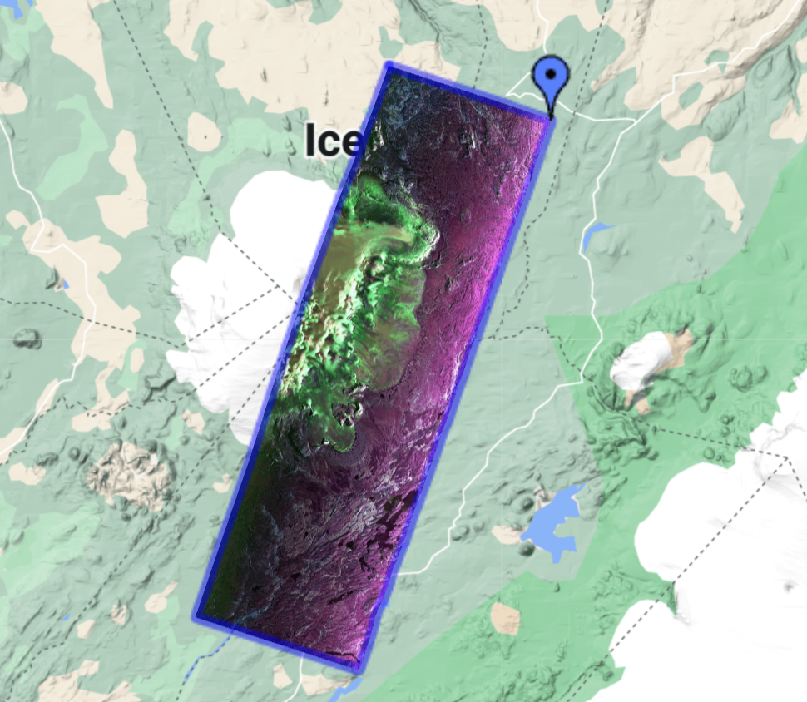
SAR Satellite Visual
June 14, 2012
May 29, 2015
The satellite maps initially helped pinpoint areas of gross geographical difference over time

Slide 6

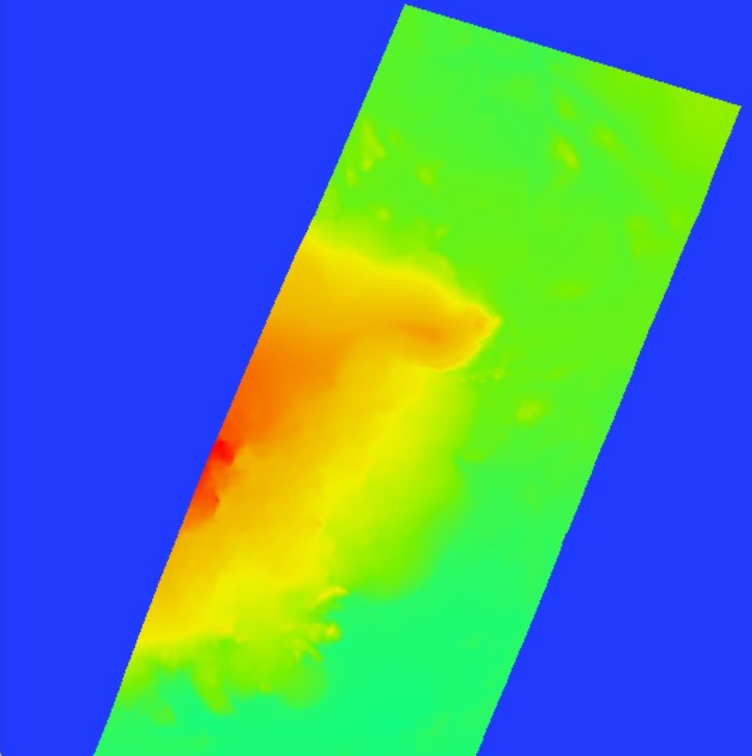
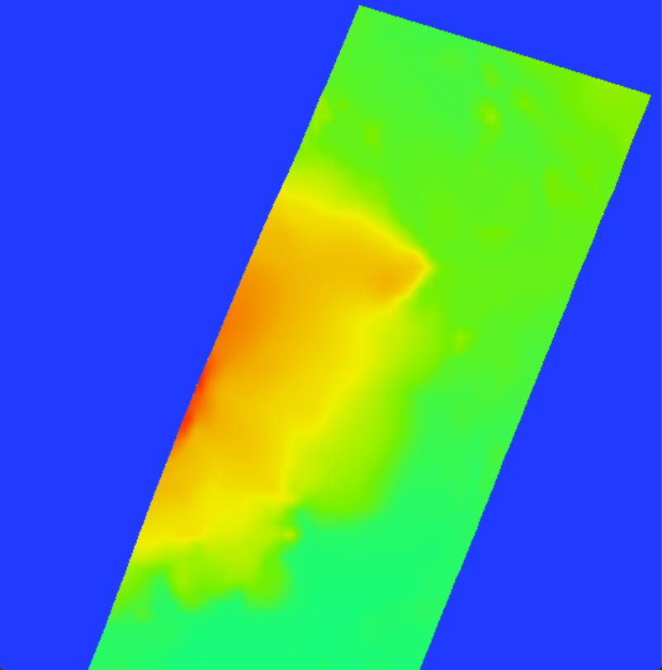
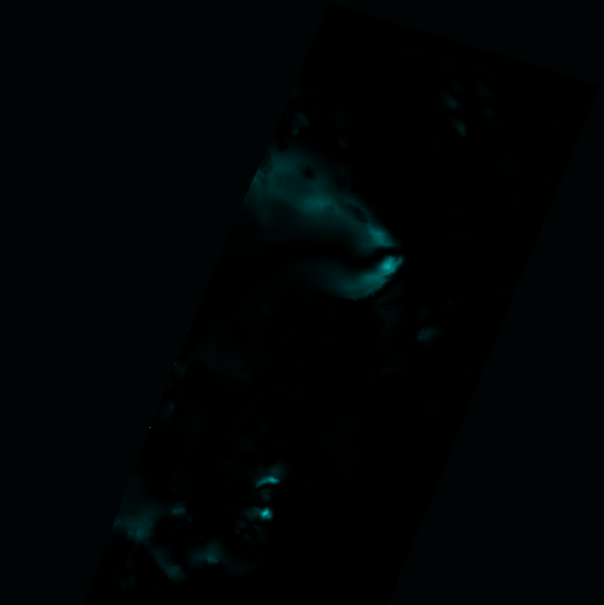
Colour Topography
June 14, 2012
May 29, 2015
Difference
By looking at the difference model, you can see the key areas in which the glacier changed from 2012 to 2015
This was caused by higher temperatures melting the glaciers

Slide 7

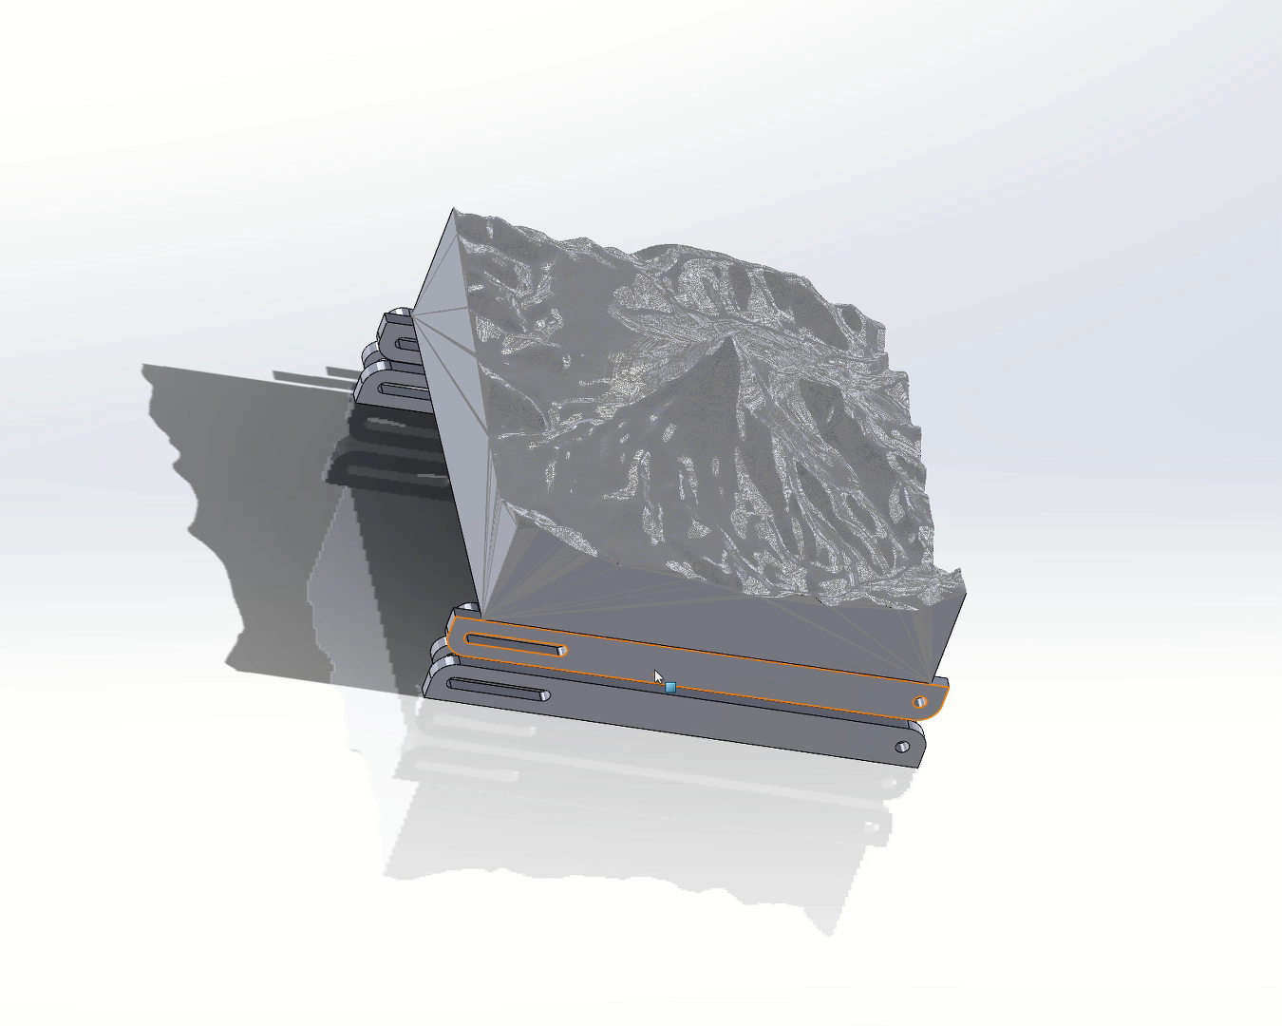
3D Topography & Software
Aimed to create a physical DEM through advanced data processing. Started with two HGT files, from SAR scans 3 years apart.
Python was used to create and read all the data into a large 2D array that contains all the heights of the SAR scan.
Overlapping area was found between these scans. Then the data from the area was resampled to get two matching resolutions.
3D project model using a sample volcano

Slide 8

Topography maps are to be run through a reconstruction algorithm to generate the surface when given the points.
The surfaces were attached to a base to create a 3D object which was exported as an STL file.
The surfaces were run through a slicing algorithm to separate the volume in to different pins.
The model has to be 3D printed and placed onto a movable base, which will display the HGT data as a physical DEM.

Slide 9
THE END
Thank you for reading!

